Slide 1


Budget Sales Analysis
Analysing the Customer data, Product data, Sales data and Budget data of a Retail chain and extract key insights that can be beneficial for business decision making.

Slide 2
Data Set Info:
This dataset contains 5 tables:
Budget Data: Contains the features of the sales of 2016 Budget.
Customer Data: Contains features regarding the customers demographics.
Sales Data: Contains the features regarding the sales of various products.
Territory Data: Contains the features of the Region of the sales.
Product Data: Contains the features of the products sold.

Slide 3
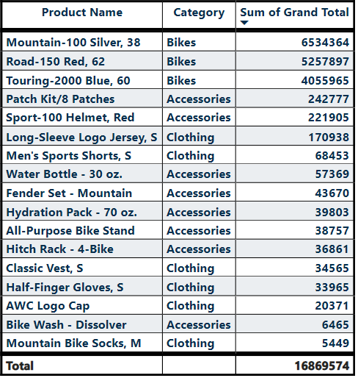
Sales Budget for year 2016
Our Sales budget is 16.86 Million
Target to sell more Accessories and Components than Bikes and Clothing.
We planned to sales our products according to demand in market
We increase our sales by producing high demand products.

Slide 4
Customer Data Analysis
Customers based on Gender, Marital status and their children count
There no higher difference based on Gender and Marital Status
It seems that couples with 2 and 4 children purchases the more next to them couples with no children purchase more.

Slide 5
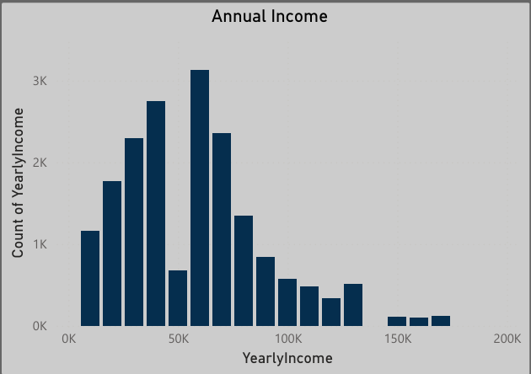
Customers based on Occupation Education and Annual Income
From the above it seems that most of our customers are from Professional background with a Bachelor’s degree.
Most of our Customers are well educated and with a stable Job.
Most customers have Annual Income between 35K -75K while customers with Annual income 150K and above are lesser.

Slide 6
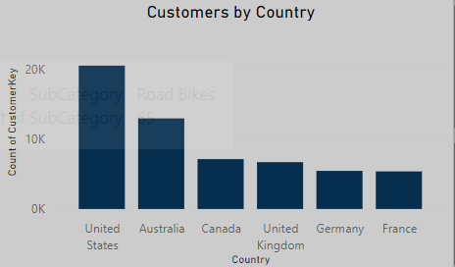
Customers by country
The most number of customers are from United States followed by Australia.
The least number of customers are from France and Germany.
Our Total Customers count is 18.48 K

Slide 7
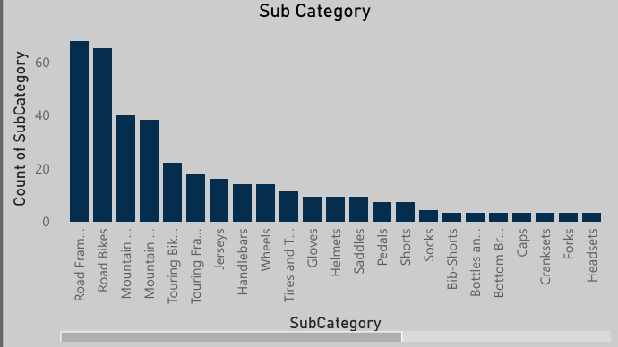
Product Analysis based on Category and Sub Category
This shows that purchase of Bikes and Components are higher compared with other categories
Road frame and Road Bikes are purchased the most followed by Mountain Frames & Bikes and the least purchased item is locks and panniers.

Slide 8
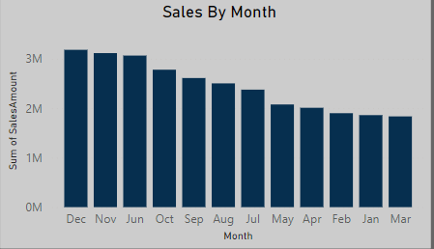
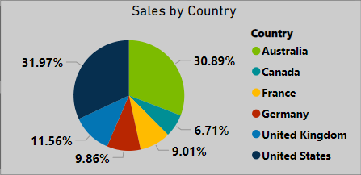
Sales Analysis: Our total Sales Figure is 29.31 Million.
The highest sales are in the month of December, November and June
It gradually increases from January to December.
The highest Sales is from United States followed by Australia.
The least Sales is from Canada and France.

Slide 9
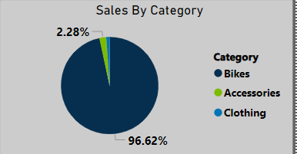
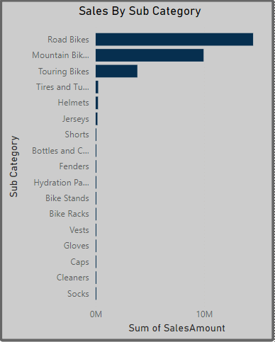
Sales based on Product Category
In Sub Category Road Bikes and Mountain Bikes has highest Sales.
Socks are least sold item.
Bikes and Components contribute the highest in sales comparing to Accessories and Clothing.

Slide 10
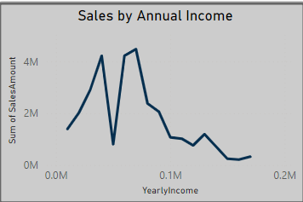
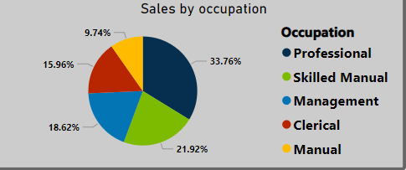
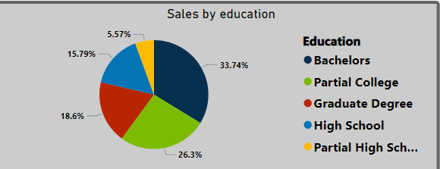
Sales By Customer Status:
Most of our Customers are well educated with a stable job and with good income.

Slide 11
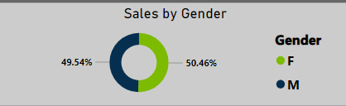
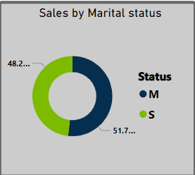
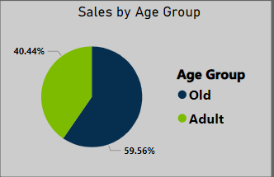
Sales based on Customer Demographics
There is no higher difference based on gender and Marital Status
Old Age group purchase more compared with Adult age group.

Slide 12
Conclusions:
We have achieved our sales target higher than our budget which implies our products sale more in the market
our customers are well educated with a stable income and purchase based on their current needs also couples with children purchase more so we can target them by producing children needs.
If we have good customer service and product quality we can have good sales. Also we can provide referral rewards to increase customer count.
Providing seasonal discount can increase our sales gradually.
In Above analysis old age group people purchase more compared with Adult group so we must work on attracting adult group for more purchase along with retaining our old customers.

Slide 13


